Slide 1
Strategic Market Simulator Team Member(s): Javier Andrial, Jeffrey Carman Product Owner(s): Joseph Cilli Instructor: Masoud Sadjadi School of Computing and Information Sciences Florida International University
Senior Project Final Presentation Fall 2015
December 11th 2015
Notes:
Greet your audience, thank them for attending your presentation, introduce yourself, introduce your project, introduce your team members, and quickly indicate what each of you did in a high-level manner, and put more emphasis on your part/contribution.

Slide 2
Problem definition
Project Problem:
University instructors need a means for teaching their students “Strategic Marketing.” Students will play apart of a simulation where they’ll be running a Hotel. Students will base their marketing decisions on the period’s current News article, the amount of available budget, the location and type of their Hotel, and the decisions of other student’s competing Hotels.
My Part:
Primarily Administrative functionality
Activate/deactive user accounts
View all users
Creating Games,Virtual students/Hotels, Administrative accounts
Writing News Articles
Generating detailed Reports
Notes:
Introduce the problem that the whole project tackles and stay focused on the parts that you have been working. Indicate if there is an existing previous system, enumerate its problems/limitations, etc.

Slide 3
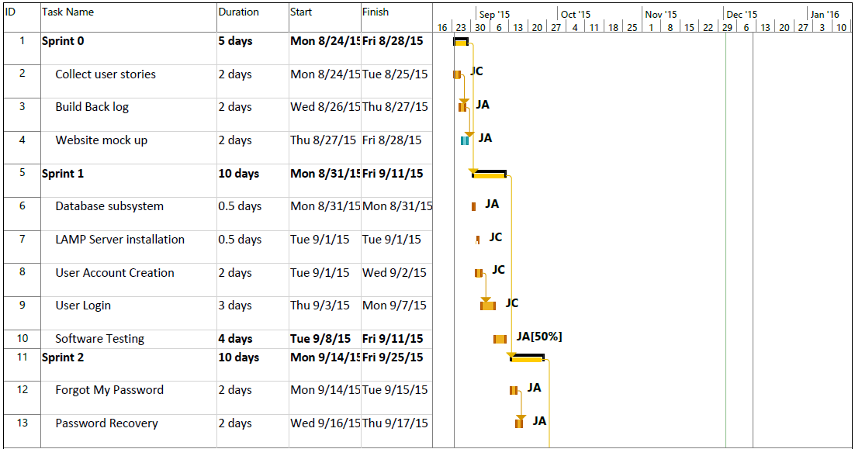
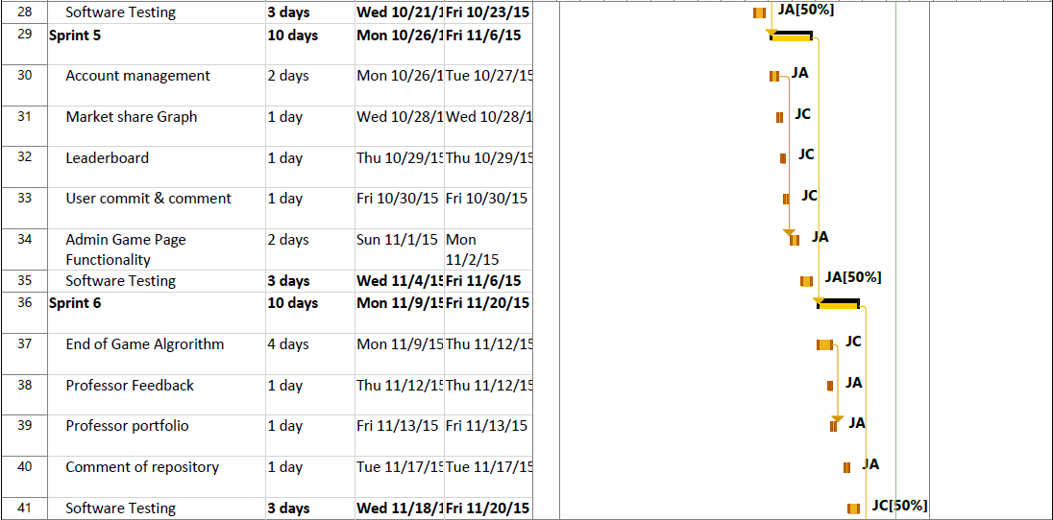
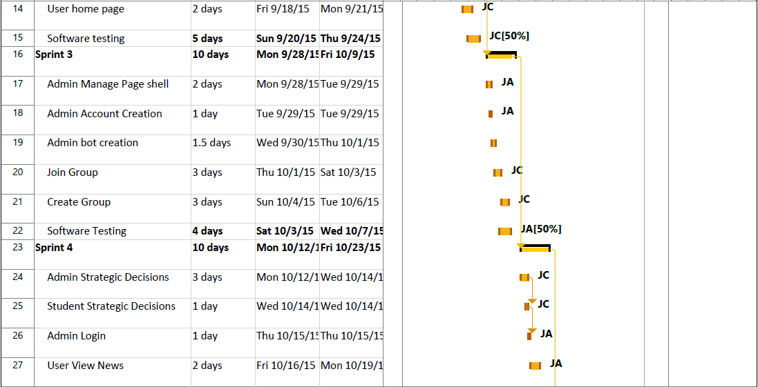
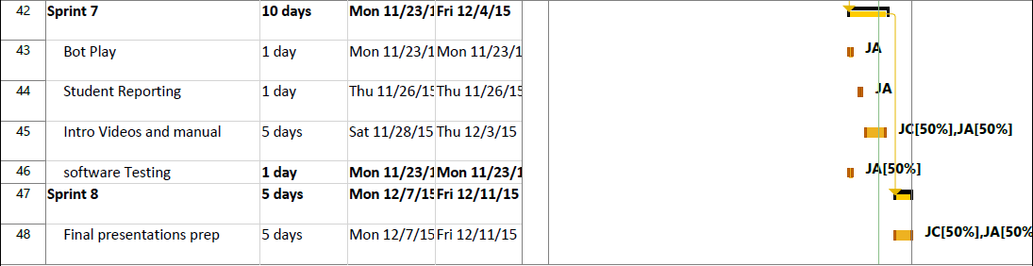
Project Management
Gantt Chart showing the schedule for entire semester
Notes:
Project Management (schedule for entire semester) (one slide; Gantt Chart).

Slide 4
Requirements: User Stories
Over the seven Sprints
A total of 35 User Stories.
I have implemented 20 User Stories
Notes:
4. Requirements:
4.1. User stories implemented (one or more slides).
4.2. UML use cases and the use case diagram for the implemented use cases (one or more slides).
4.3. UML sequence diagrams for the implemented use cases.

Slide 5
Requirements: User Stories
#667 Forgot my password
#718 Manage page
798 Admin account creation
#711 De-activate users
#689 Create game
#686 Admin Game Page functional
#685 Admin games page
#684 Bot creation
#683 Admin account creation
#681 Admin "users" page
Notes:
4. Requirements:
4.1. User stories implemented (one or more slides).
4.2. UML use cases and the use case diagram for the implemented use cases (one or more slides).
4.3. UML sequence diagrams for the implemented use cases.

Slide 6
Requirements: User Stories
#680 Admin home
#800 Admin News Management
#679 User view news
#822 Sign out
#816 Account Management
#842 Professor Feedback
#841 Professor Portfolio
#840 Comment Repository
#853 Student Reporting Page
#710 User toolbar
Notes:
4. Requirements:
4.1. User stories implemented (one or more slides).
4.2. UML use cases and the use case diagram for the implemented use cases (one or more slides).
4.3. UML sequence diagrams for the implemented use cases.

Slide 7
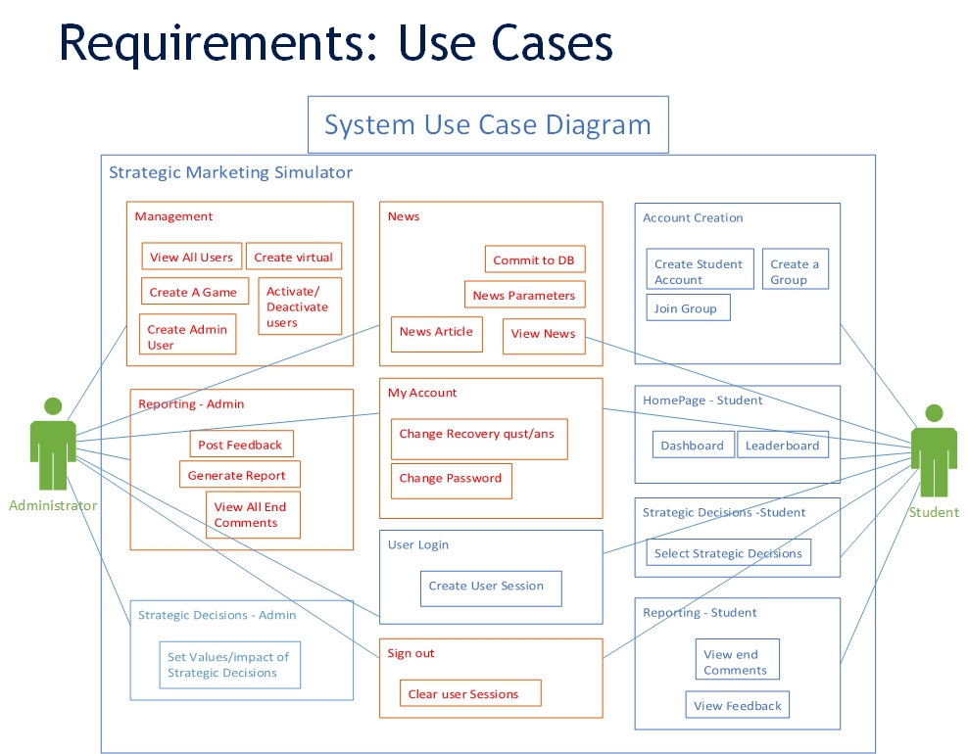
Requirements: Use Cases
Show the Use Case Diagram for the whole project.
Highlight your use cases.
Show all the details of the most significant use case.
Notes:
4. Requirements:
4.1. User stories implemented (one or more slides).
4.2. UML use cases and the use case diagram for the implemented use cases (one or more slides).
4.3. UML sequence diagrams for the implemented use cases.

Slide 8
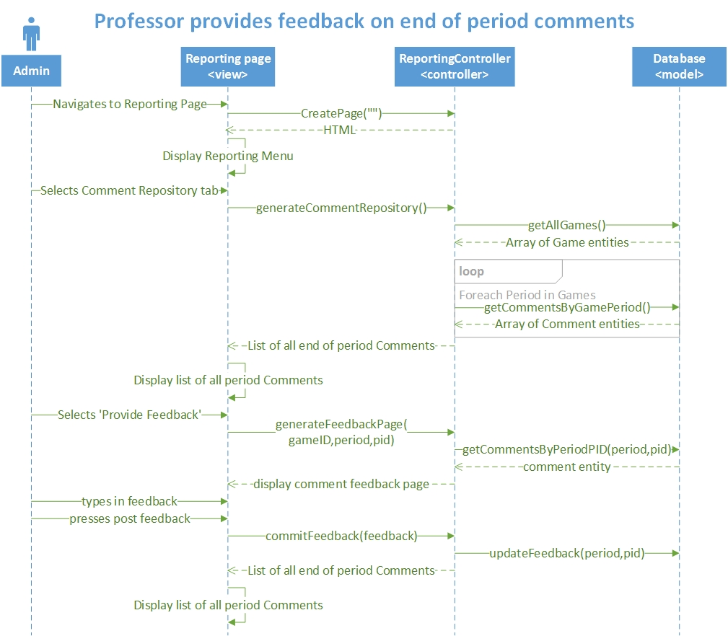
Requirements: Sequence Diagrams
Show the sequence diagram of the most significant use case.
Notes:
4. Requirements:
4.1. User stories implemented (one or more slides).
4.2. UML use cases and the use case diagram for the implemented use cases (one or more slides).
4.3. UML sequence diagrams for the implemented use cases.

Slide 9
System Design: Architecture
The Architecture of the System uses the Model-View-Controller Design
Views – receives user input, calls the controller functions, displays page in HTML
Controllers - Handles all logic, sanity checks, calls the Model, returns HTML to View to draw page.
Model – Queries the Database, create and update entries and returns
Notes:
5. System design:
5.1. System decomposition; identify the architecture patterns used (one slide).
5.2. System deployment – h/w and s/w requirements (one slide).
5.3. Persistent data design (one slide).
5.4. Security/Privacy (one slide).
System decomposition: Identify the architecture patterns used: Highlight the parts that you contributed to them

Slide 10
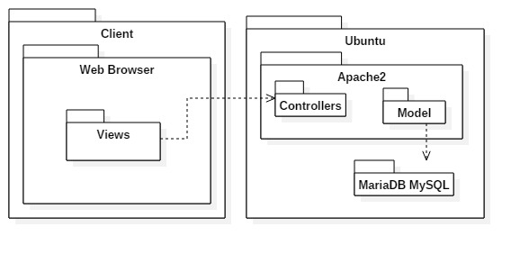
System Design: Deployment
Requirements:
Notes:
5. System design:
5.1. System decomposition; identify the architecture patterns used (one slide).
5.2. System deployment – h/w and s/w requirements (one slide).
5.3. Persistent data design (one slide).
5.4. Security/Privacy (one slide).
System Deployment Diagram
Highlight the parts that you contributed to them

Slide 11
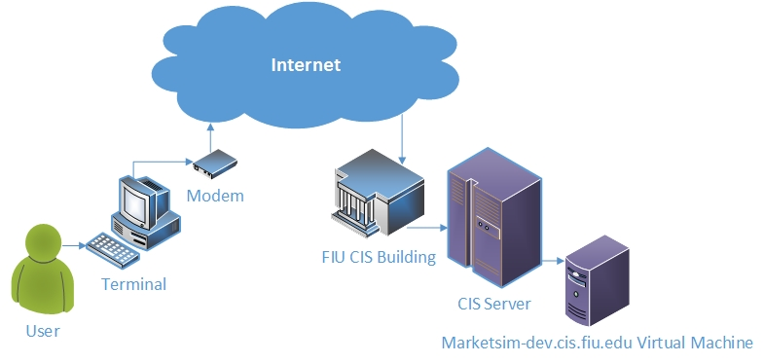
System Design: Deployment
Requirements:
Notes:
5. System design:
5.1. System decomposition; identify the architecture patterns used (one slide).
5.2. System deployment – h/w and s/w requirements (one slide).
5.3. Persistent data design (one slide).
5.4. Security/Privacy (one slide).
System Deployment Diagram
Highlight the parts that you contributed to them

Slide 12
System Design
Persistent data
Database data is stored on Disk using MariaDB system
Temporary information, such as user sessions are stored in Memory
Notes:
5. System design:
5.1. System decomposition; identify the architecture patterns used (one slide).
5.2. System deployment – h/w and s/w requirements (one slide).
5.3. Persistent data design (one slide).
5.4. Security/Privacy (one slide).
Persistent data design
Security/Privacy

Slide 13
System Design
Security
An email and password are required to Login
In the event of security breach, all Passwords and Secret Answers are stored to the Database using sha256 hash function; which cannot easily be reverted backwards.
Sessions are cleared upon leaving the system
Notes:
5. System design:
5.1. System decomposition; identify the architecture patterns used (one slide).
5.2. System deployment – h/w and s/w requirements (one slide).
5.3. Persistent data design (one slide).
5.4. Security/Privacy (one slide).

Slide 14
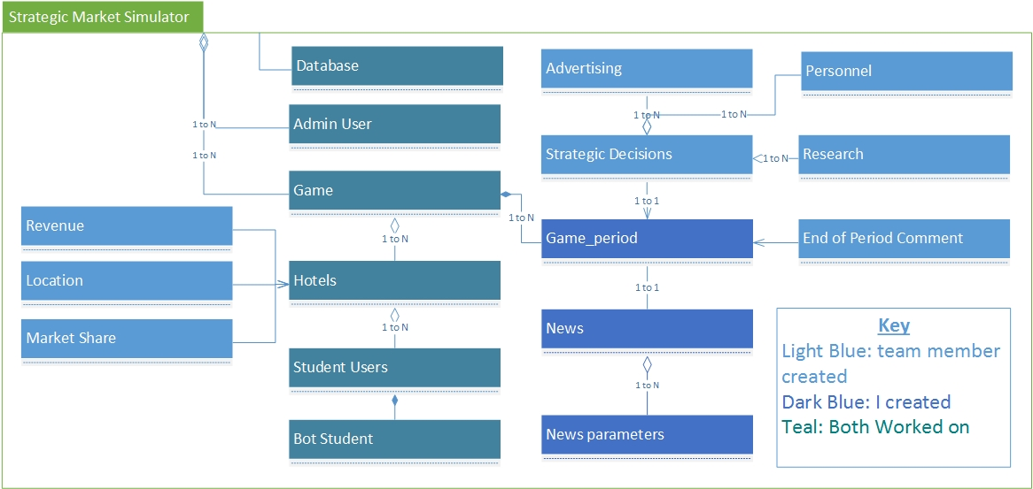
Minimal Class Diagram
Identify the design patterns used
Highlight the classes that you created/modified
Notes:
6. Detailed design:
6.1. Minimal class diagram. Identify the design patterns used (one or more slides).
6.2. State machine for the main control object or the most important object of the implemented uses cases (one or more slides).
6.3. Main algorithm used related to an implemented use case described above (one or more slides).

Slide 15
Main algorithm
Generating the PDF Report Algorithm Initializing
Start off with
Game_id = some int, Period = some int
Get Game entity from Game_id
Get All Hotels from Game_id
Get News from Game_id and Period
Get All News Parameters from News_id
…
Notes:
6. Detailed design:
6.1. Minimal class diagram. Identify the design patterns used (one or more slides).
6.2. State machine for the main control object or the most important object of the implemented uses cases (one or more slides).
6.3. Main algorithm used related to an implemented use case described above (one or more slides).
Show an interesting algorithm (pseudo code)

Slide 16
Main algorithm - cont
Generating the PDF Report Algorithm Printing - Game
Print (Game.ID, Game.course, Game.Schedule, Game.section,…)
Foreach (n : News parameters)
{
print (n.location, n.hotelType, n.effect)
}
…
Notes:
6. Detailed design:
6.1. Minimal class diagram. Identify the design patterns used (one or more slides).
6.2. State machine for the main control object or the most important object of the implemented uses cases (one or more slides).
6.3. Main algorithm used related to an implemented use case described above (one or more slides).
Show an interesting algorithm (pseudo code)

Slide 17
Main algorithm - cont
Generating the PDF Report Algorithm Printing – Hotel(s)
Foreach (h : Hotels)
{
Get Market Share from h.id
Get HotelLocation from h.id
Get All Students from h.id
Print (h.ID, HotelLocation.location, h.type, h.budget, h.revenue, …)
Print (Market Share.RoomsSold, Market Share.marketSize)
Foreach (s : Students)
{
Print (s.fname + s.lname, s.PID, s.email, s.isActive)
}
Print (endPeriodComment.comment)
}
Notes:
6. Detailed design:
6.1. Minimal class diagram. Identify the design patterns used (one or more slides).
6.2. State machine for the main control object or the most important object of the implemented uses cases (one or more slides).
6.3. Main algorithm used related to an implemented use case described above (one or more slides).
Show an interesting algorithm (pseudo code)

Slide 18
Test Suites and Test Cases
TestID: | Admin_comment_repository_Sunny_Day_102
Test Purpose | Test Admin comment repository for Sunny Day
Test Setup | System displays the comment repository page for an Instructor
Inputs | MAR3251 Check box selected
 | Period 2 Check box selected
 | Instructor clicks “Give Feedback” for “Mike’s Group”
 | Instructor enters “Good Job!” in the Feedback text area
 | Instructor clicks “Post Feedback” button
Expected Output: | The System has successfully updated “Mike’s Group” with the instructors Feedback. System displays a message saying it was successful.
Sunny Day
Rainy Day
Automated test scripts, if any
Notes:
7. Test Suites and Test Cases (one sunny day and one rainy day) for the use case represented in part (5) above (2 slides).
7.1 One sunny day and one rainy day for the implemented use cases (one or more slides).
7.2 Automated test scripts for the implemented use cases (one or more slides).

Slide 19
Test Suites and Test Cases
TestID: | Admin_comment_repository_Rainy_Day_103
Test Purpose | Test Admin comment repository for Rainy Day
Test Setup | System displays the comment repository page for an Instructor
Inputs | MAR3251 Check box selected
 | Period 2 Check box selected
 | Instructor clicks “Give Feedback”
 | Instructor clicks “Post Feedback” button
Expected Output: | System Validates the input and displays a failed message stating, ‘unable to post feedback. Feedback was either blank or the same.’
Sunny Day
Rainy Day
Automated test scripts, if any
Notes:
7. Test Suites and Test Cases (one sunny day and one rainy day) for the use case represented in part (5) above (2 slides).
7.1 One sunny day and one rainy day for the implemented use cases (one or more slides).
7.2 Automated test scripts for the implemented use cases (one or more slides).

Slide 20
Summary
Strategic Marketing Simulator
Work primarily on Administrative Use Cases for
Javier Andrial Email: jandr018@fiu.edu phone: (305)323-9971
Thank you very much for listening!
Feel free to ask any questions?
Notes:
Summarize your contribution
Include your contact information
Ask if anyone has any questions for you.
Thank your audience

